Slide 1

Healthcare Provider Fraud Detection
GROUP MEMBERS: Lenin Goud Athikam
Saketha Kusu
Varshitha reddy Devarapalli Rashmitha Eri
Karunakar Uppalapati
Kavya pachchava.

Slide 2



Problem Statement
Detect potentially fraudulent providers based on medicare claims data.
Understand key features contributing to fraud.
Analyze behavioral patterns in fraudulent claims.

Slide 3
Dataset Description
•Inpatient Data: Claims for admitted patients.
•Outpatient Data: Claims for patients who are not admitted.
•Beneficiary Data: Demographics and various health conditions.
•Labels: Potential Fraud (Yes/No)

Slide 4
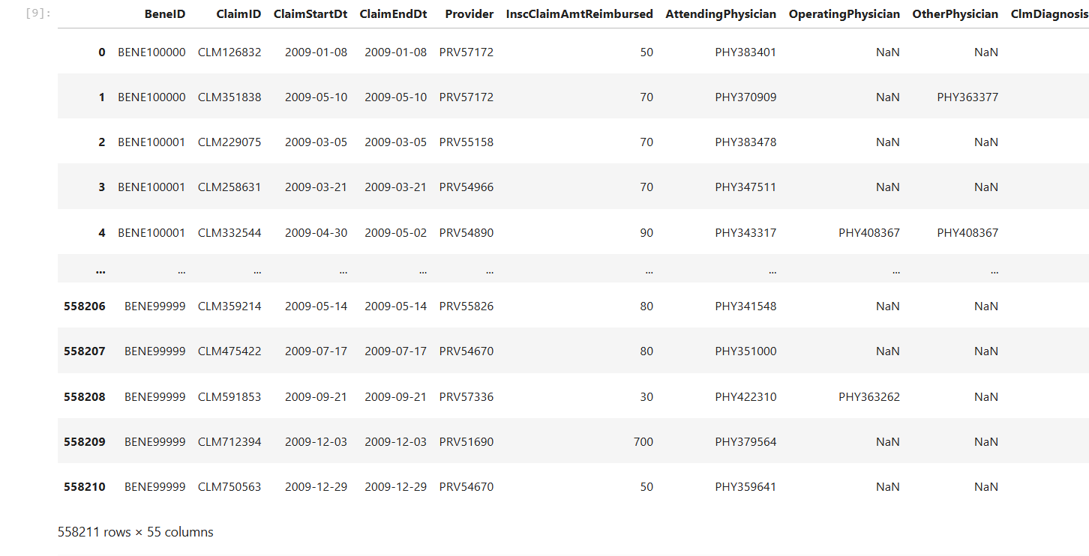
Data snapshot
558211-rows
55 columns

Slide 5
Columns:
The combined dataset contains over 558,000 rows and 55 columns. Some key fields include:
BeneID, ClaimID for identification,
ClaimStartDt, ClaimEndDt for tracking duration,
Up to 10 diagnosis codes and 6 procedure codes per claim,
Chronic condition indicators like diabetes, stroke, heart failure, and more,
And the final target label: Potential Fraud.”

Slide 6
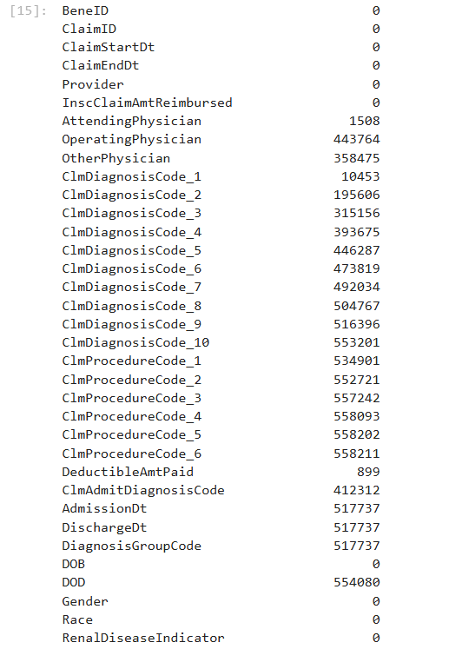
Checking missing values
Dropping uninformative columns,
Imputing values where reasonable
Many missing values

Slide 7
Data Preprocessing
•Merged inpatient, outpatient, and beneficiary data.
Outer join,because not all patients have both inpatient and outpatient records.
•Converted dates to datetime format.
-Admissions , Discharges, ClaimStartDt, ClaimEndDt
•Handled missing values and encoded categorical variables.
Clm Admit Diagnosis Code,Provider, ClaimID.BeneID,Race,Gender
•Engineered claim duration and chronic condition counts.
Total Deductible Paid, Total Reimbursement,claim_duration,same_physician,Age

Slide 8
Feature Engineering
•Number of Chronic Conditions per beneficiary.
•Age created from DoB and DOD(missing dod is filled with last available date)
•Claim Duration: Difference between ClaimStart and ClaimEnd.
•Encoded categorical features like gender and diagnosis codes. and diagnosis codes.
•Aggregated claims per provider.

Slide 9
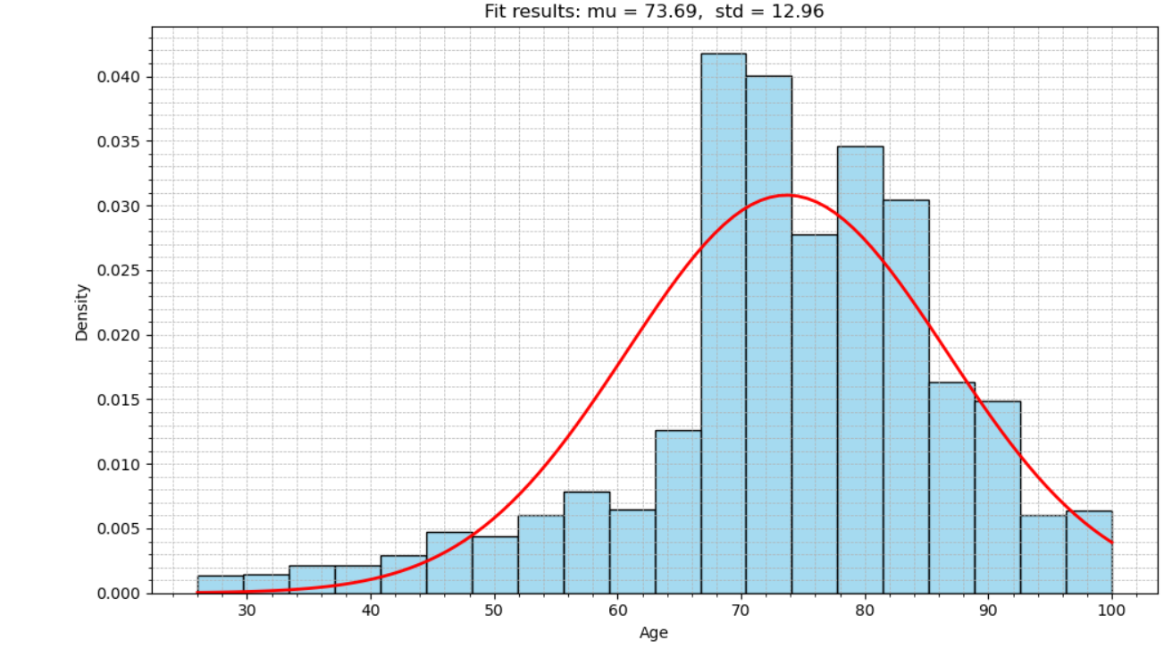
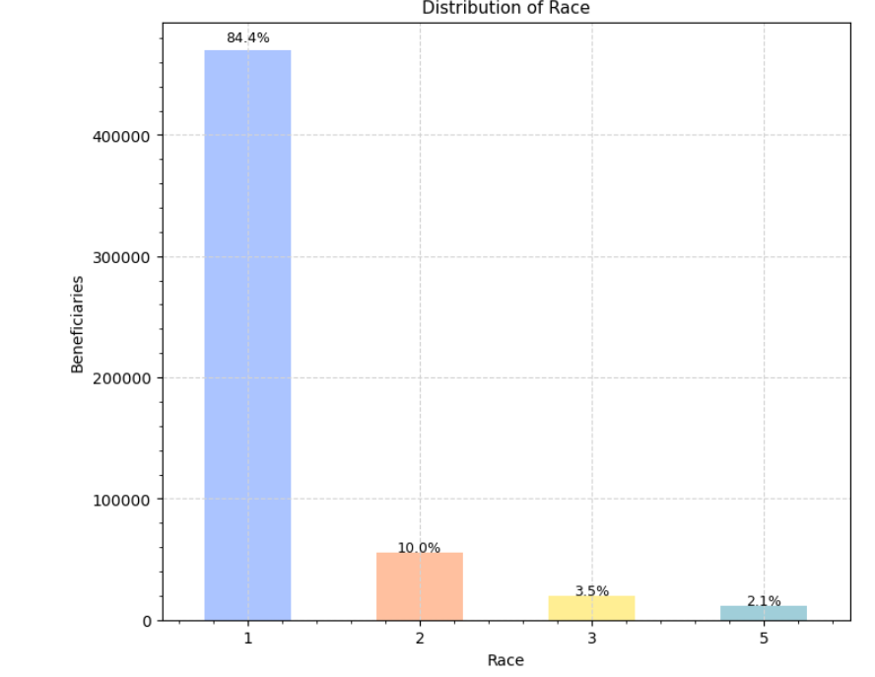
Distributions

Slide 10
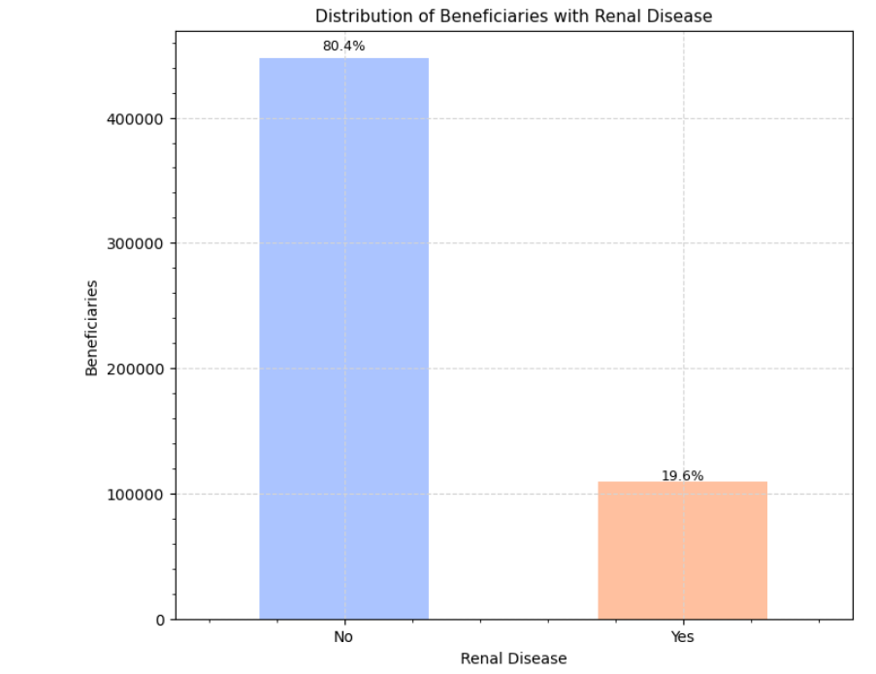
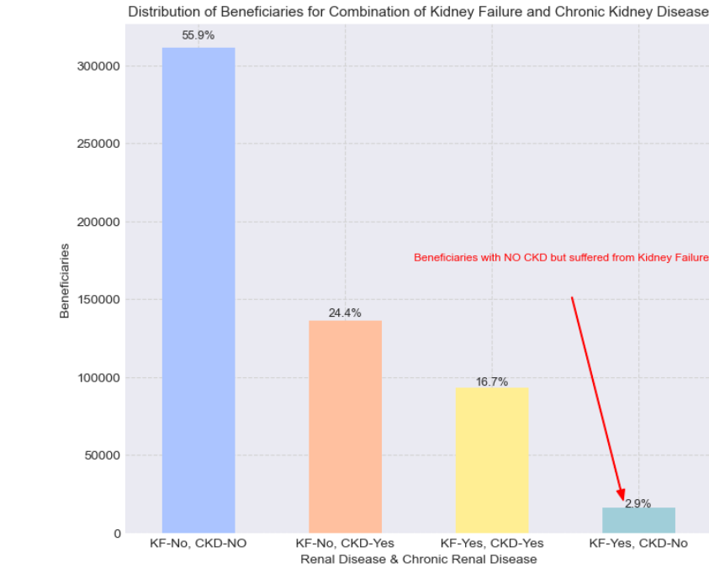
contd..

Slide 11
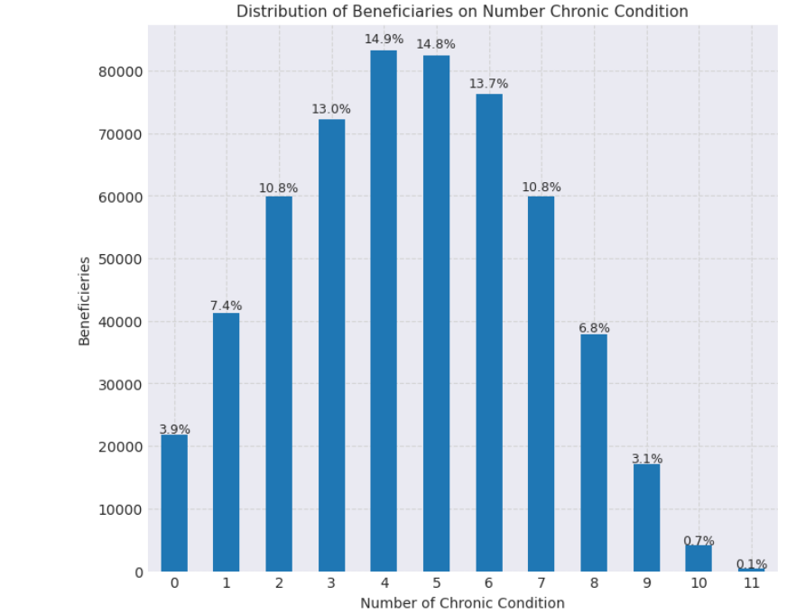
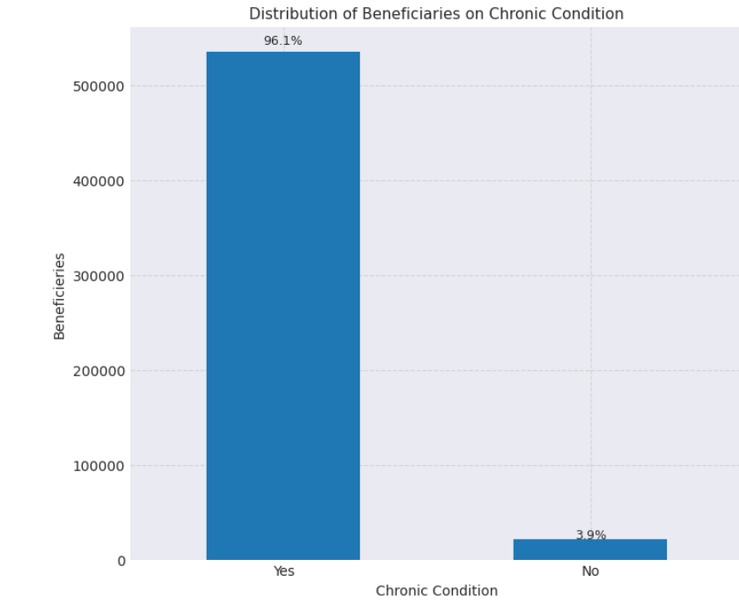
contd..

Slide 12
Model Selection
•Used classification models to detect fraud:
• Decision Tree
• Random Forest
Splitted data into Train and Test data(80-20)

Slide 13



Evaluation Metrics
•Accuracy, Precision, Recall, F1-Score used.
•ROC-AUC score for better fraud class sensitivity.
•Focused on minimizing false negatives (undetected frauds).--Decision Tree

Slide 14
Hyperparameter Tuning
Used GridSearchCV to find the best model settings. Tuned max_depth of Decision Tree between 5 and 15. Found depth = 13 gave best balance (avoids overfitting). Tuned min_samples_split with values like 2, 5, 10. Final model was more accurate and generalized well. Tuning improved fraud detection and reduced false positives.

Slide 15
Final Model - Decision Tree (depth=13)
Decision Tree Image
Decision Tree depth = 13
Accuracy: 94%, Recall: 88%
Visual: Insert tree plot or confusion matrix

Slide 16
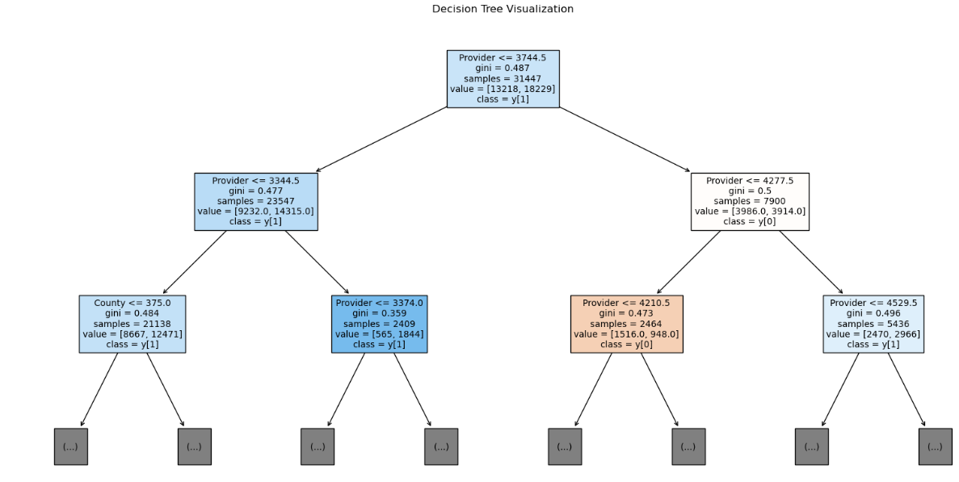
Decision tree visualization
(truncated for better visibility)

Slide 17
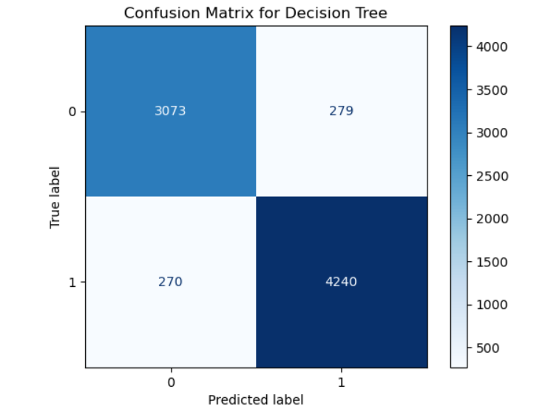
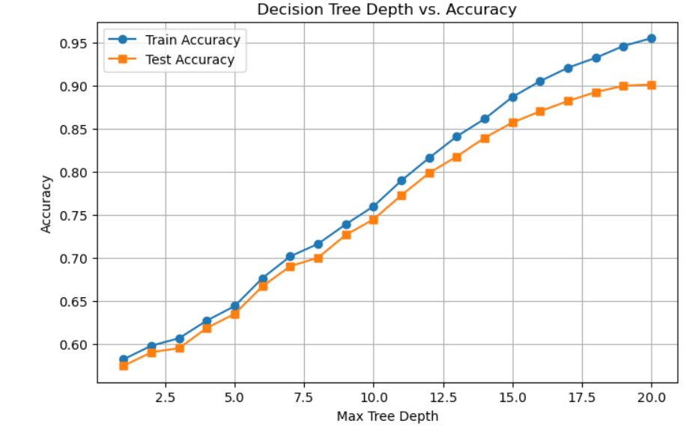
Results of Decision tree
After depth 13 training & test accuracy is varying so we chose optimal depth as 13

Slide 18
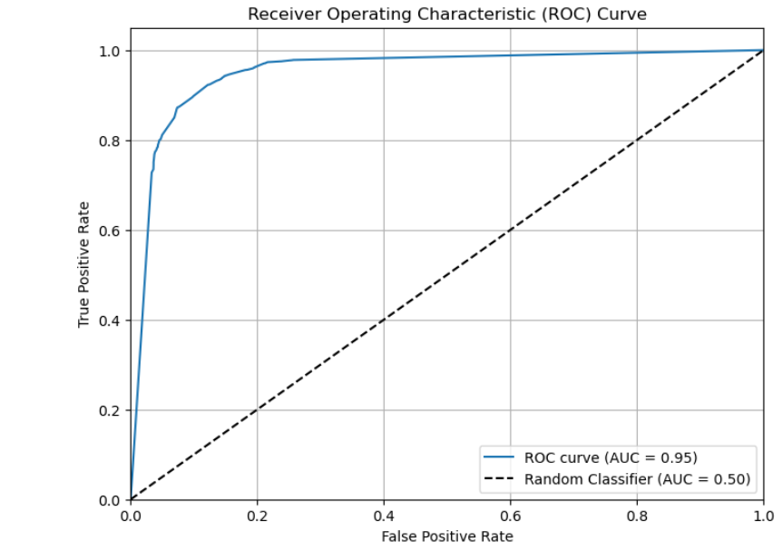
Roc curve
Optimal value as tpr is high also fpr is low

Slide 19
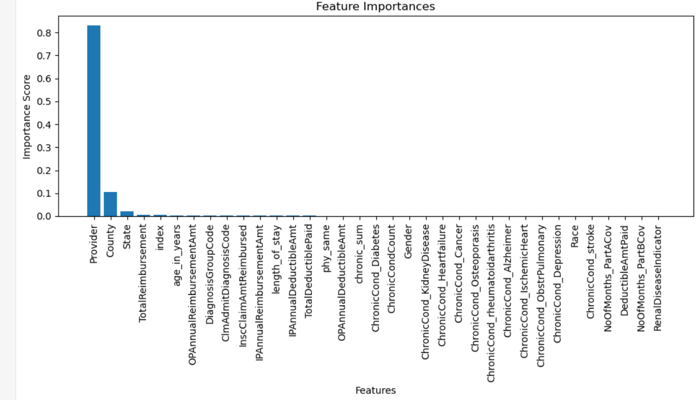
Feature importance

Slide 20
Key Insights
•Chronic conditions and long claim durations are fraud indicators.
•Provider history is vital for detecting patterns.
•Model can support claim investigation teams effectively.

Slide 21
Challenges
Missing/incomplete data
Imbalanced class distribution
Merging multiple datasets cleanly
Balancing accuracy with false positives/negatives Ensuring generalization without overfit Limited labeled fraud data

Slide 22



Conclusion & Future Work
ML models are effective in detecting healthcare fraud.
Can be integrated into claim processing pipelines.
Future: Use deep learning for even better predictions

Slide 23


